Slide 1

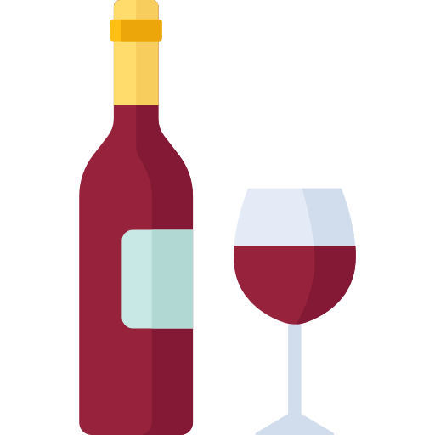
RED WINE QUALITY
Team ROBUST

Slide 2

Group information
Name | ID
Rubaiyad Noor Shahriar | 19-39541-1
Muhammad, Akib | 19-39372-1
Md. Adnan Shakib | 18-38015-2
Md Amir Habib | 19-41429-3

Slide 3
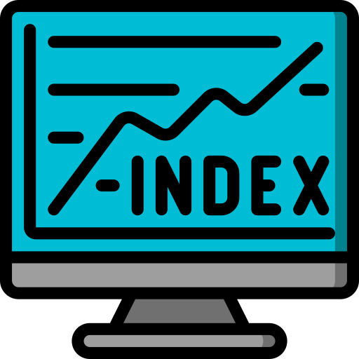
Index
Introduction
Background Study
Problem statement
State-of-arts
Proposed Method
Dataset
Proposed Solution
Analysis
Discussion
Reference

Slide 4

Introduction
Wine is an alcoholic drink typically made from fermented grapes. Yeast consumes the sugar in the grapes and converts it to ethanol and carbon dioxide. Different varieties of grapes and strains of yeasts are major factors in different styles of wine. Wines not made from grapes involve fermentation of other crops including rice wine and other fruit wines.
Wine has been produced for thousands of years. The earliest evidence of wine is from ancient China (c. 7000 BC) Georgia (6000 BC), Persia (5000 BC), and Italy (4000 BC). New World wine has some connection to alcoholic beverages made by the indigenous peoples of the Americas.
Viticulture traditions in the Southwestern United States started within New Spain as Catholic friars and monks first produced wines in New Mexico and California. Similarly, the largest wine regions in Italy, Spain, and France have heritages in connection to sacramental wine.

Slide 5

Problem Statement
The two datasets are related to red and white variants of the Portuguese "Vinho Verde" wine. For more details, consult the reference [Cortez et al., 2009]. Due to privacy and logistic issues, only physicochemical (inputs) and sensory (the output) variables are available (e.g., there is no data about grape types, wine brand, wine selling price, etc.).
These datasets can be viewed as classification or regression tasks. The classes are ordered but not balanced (e.g., there are much more normal wines than excellent or poor ones).
We are going to classify this dataset according to the value of the quality. Due to privacy and logistic issues, only physicochemical (inputs) and sensory (sensory) variables are available. The classes are ordered but not balanced (e.g., much more normal wines than excellent or poor ones).

Slide 6

State-of-Arts
Paper Title | Application | Author
A machine learning application in wine quality prediction | Gradient Decision Classifier | Piyush Bhardwaj
Red Wine Quality Prediction Model | SVM | Sunday Oladeji
Red Wine Quality Prediction Using Machine Learning Techniques | Naïve Bayes, SVM | Sunny Kumar
Research on Red Wine Quality Based on Data Visualization | Pearson correlation coefficient algorithm | Shuhao Zhang

Slide 7

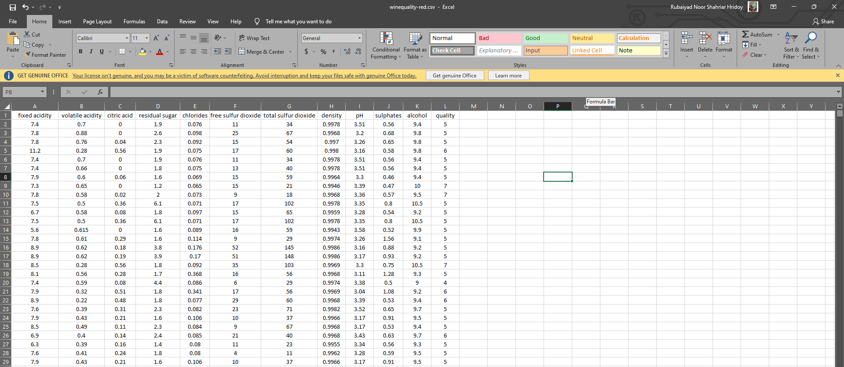
Proposed Method
We will be using Naïve bayes algorithm, K-Nearest Neighbour algorithm and Decision tree algorithm to classify the dataset. There are 5 classes which are numerical but determine the quality of the wine. We will provide a comparative discussion on which classification algorithm provides the most efficient result.

Slide 8

Proposed Solution
Importing libraries required for Wine Quality Prediction
Take info from data
Read input data
Describe the data
Counting the no. of instances of each class
Making just 2 categories good and bad
Allotting 0 to bad and 1 to good
Plotting out the data

Slide 9
Proposed Solution (Cont.)
Again checking the counts of classes in new data frame
Checking correlation between columns
Again checking counts
Balancing the two classes
Finally training our Wine Quality Prediction model
Finalizing Classification method
Splitting the data in train and test

Slide 10

Analysis
The analysis of the dataset using the WEKA tool compare among data mining classification algorithms (Decision tree, KNN, Naive Bayas) shows that all KNN algorithms are more accurate and they have less error rate and they are easier algorithms as compared to the Decision tree and Naive Bayas.
The result of implementation in WEKA on the same dataset showed that the Decision Tree outperforms and Bayesian classification are less than the accuracy of KNN. The comparative study has shown that each algorithm has its own set of advantages and disadvantages as well as its own area of implementation.
None of the algorithms can satisfy all constraints and criteria. Depending on the application and requirements, a specific algorithm can be chosen. We think KNN will be the right choice for this dataset according to the WEKA result.

Slide 11


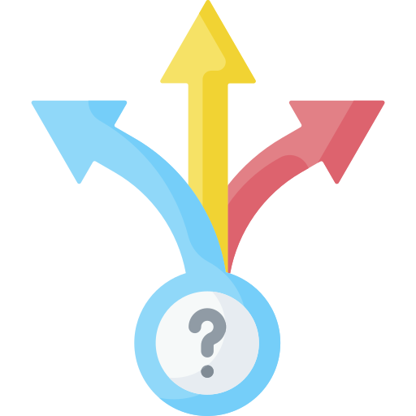
Discussion
The analysis of the dataset using the WEKA tool comparison among data mining classification algorithms (Decision tree, KNN, Naive Bayas) shows that all KNN algorithms are more accurate. The result of implementation in WEKA on the same dataset showed that the Decision Tree outperforms and Bayesian classification.
We will be implementing this theoretical analysis on Jupyter using Python. After the implementation we can compare the differences more precisely

Slide 12

References
https://ieeexplore.ieee.org/document/9137477
https://www.researchgate.net/publication/341812162_Red_Wine_Quality_Prediction_Using_Machine_Learning_Techniques
https://papers.ssrn.com/sol3/papers.cfm?abstract_id=3735104
https://www.sciencedirect.com/science/article/pii/S266682702200007X (main)

Slide 13


Contacts
rubaiyadnoorshahriar@gmail.com
akibmoeee@gmail.com
adnanshakib1999@gmail.com
habibamir92@gmail.com

